Slide 1

BUFN 736 QEPM Backtesting Project
Iordan Koulov, Ksenia Popovich,
Aman Sharma, Pranav Senthil

Slide 2
Agenda:
Factor Explore
Factor Creation & Selection
Model
Portfolio Performance Evaluation: LS & Long
Portfolio Comparison

Slide 3
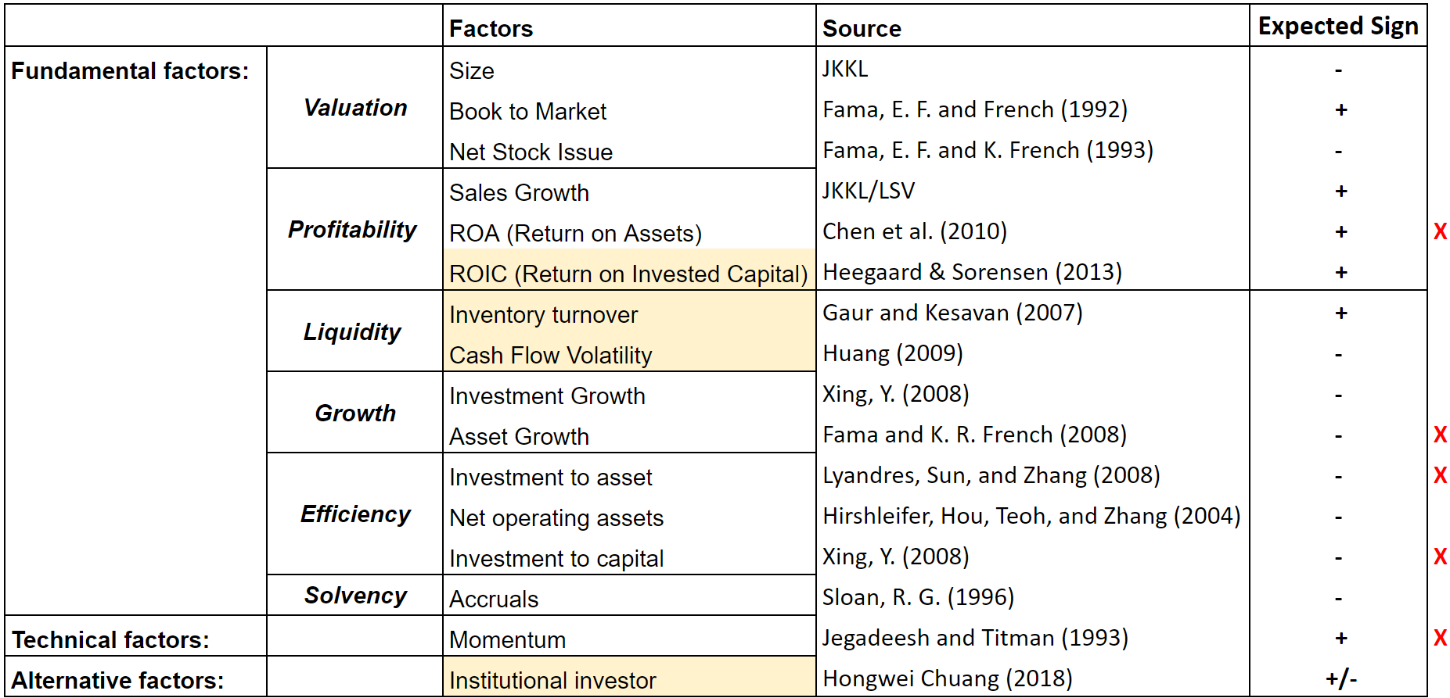
Factor explore: Initial Factors (12+4)
Notes:
Our model emphasizes fundamental values, its primary focus is on understanding the intrinsic value of the companies as most of the factors included are related to a company's financial health, performance, and growth. Additionally we have some alternative factors.
Talk more about the factors
The factors that we created are: our 4 factors
Please check whether the factors are all there what is in the model
Mention why we didn’t use:
Asset Growth-
Momentum -
Investment to Asset -
Investment to Capital -
ROA -
ROIC -
Maybe we could club them on the basis of when we dropped them, like ROA, IA and IK we dropped before running the regression - because of correlation and others we dropped after running correlation because they gave wrong sign etc etc.

Slide 4
Factor Creation

Slide 5
ROIC - Heegaard & Sorensen (2013)
Expect to see a positive relationship between ROIC quality ratio and future returns
Used average ROIC volatility over 5 years:
ROIC quality ratio serves as a screening tool in strategy development
Higher ratios suggest better financial efficiency
Combination of ROIC with valuation metrics and growth metrics is a good way to diversify the portfolio
Computation:
ROIC = Net Operating Profit After Tax / Invested Capital
ROIC average 5 years ÷ Standard deviation of ROIC over 5 years
Notes:
return on invested capital is the overall profitability measure for operations
In a quantitative strategy, investors can use the ROIC to rank potential investments based on their financial efficiency. Companies with higher ratios may be given higher weightings in the portfolio, while companies with lower ratios may be excluded or given lower weightings. When combined with other factors, such as valuation metrics, growth rates, and dividend yields, the ROIC quality ratio can help investors build a diversified portfolio of high-quality companies that have the potential to generate strong returns over the long term.
Overall, it can be used as a screening tool in the development of quantitative investment strategies, but investors must be mindful of the potential trade-offs between risk and return when constructing portfolios based on this metric.

Slide 6
Institutional Holdings - Chuang (2018)
Short-term positive impact on stock returns due to institutional trading
Potential long-term negative effects due to short-term focus and herding behavior
Stocks with lower accumulated growth of institutional ownership exhibit greater momentum
Computation:
Total Shares Bought/Sold by institutional investors (Company A, Period T) ÷ Total Shares Outstanding (Company A, Period T)
Notes:
institutional trading not only has a short-term positive impact on stock returns but can also have a long-term negative effect. Moreover, I find that stocks with the lower accumulated growth of institutional ownership tend to have greater momentum than stocks with higher such growth. A zero-investment strategy of buying stocks with ‘LOW’-decile institutional ownership and selling ‘HIGH’-decile ones can outperform the market and generate significant abnormal returns.

Slide 7
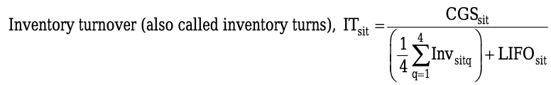
Inventory Turnover - Gaur & Kesavan (2009)
The Effects of Firm Size and Sales Growth Rate on Inventory Turnover Performance in the U.S. Retail Sector
Expected to see Positive correlation between Inventory turnover and sales growth
Higher Inventory turnover → Sales Growth → High Returns
Computation:
Then used the log of IT to test their hypothesis
Notes:
The study also finds a significant interaction effect between firm size and sales growth rate on inventory turnover performance. The negative impact of firm size on inventory turnover is stronger for firms with lower sales growth rates, while the positive impact of sales growth rate on inventory turnover is stronger for smaller firms. This finding suggests that smaller firms with higher sales growth rates are more agile and better able to manage their inventory efficiently than larger firms with lower sales growth rates.
Hypothesis 1(a). Inventory turnover of a firm is positively correlated with changes in its size. Hypothesis 1(b). Inventory turnover of a firm is negatively correlated with changes in its size.
Hypothesis 2(a). Inventory turnover of a firm is positively correlated with changes in its sales ratio in the sales expansion region as well as the sales contraction region. Hypothesis 2(b). Inventory turnover of a firm is negatively correlated with changes in its sales ratio in the sales expansion region as well as the sales contraction region. Hypothesis 3. Inventory turnover of a firm is more sensitive to sales ratio in the sales contraction region than in the sales expansion region.

Slide 8
Cash Flow Volatility - Huang (2009)
Higher CF volatility → Greater uncertainty or risk associated with the company's future CF → Investor demands higher return → Lower stock price & future returns
Used Cash flow to Sales:
Sales is used in many studies as a measure of firm size (studies like Berk, 1997)
Using sales as the scalar has the advantage of addressing seasonality in cash flow
Computation:
Rolling standard deviation of cash flow margins over the past 16 months
At least 8 non missing observation of cash flows within the estimation window
The CF volatility effect is closely related to the idiosyncratic return volatility effect documented in Ang et al*.
*Ang, A., Hodrick, R.J., Xing, Y. and Zhang, X. “The cross-section of volatility and expected returns.” Journal of Finance, 51 (2006), 259–299
Notes:
Irvine and Pontiff (in press) argue that cashflow shocks and increased economy-wide market competition are primary
drivers for the documented trend in return volatility.

Slide 9
Factor Selection

Slide 10
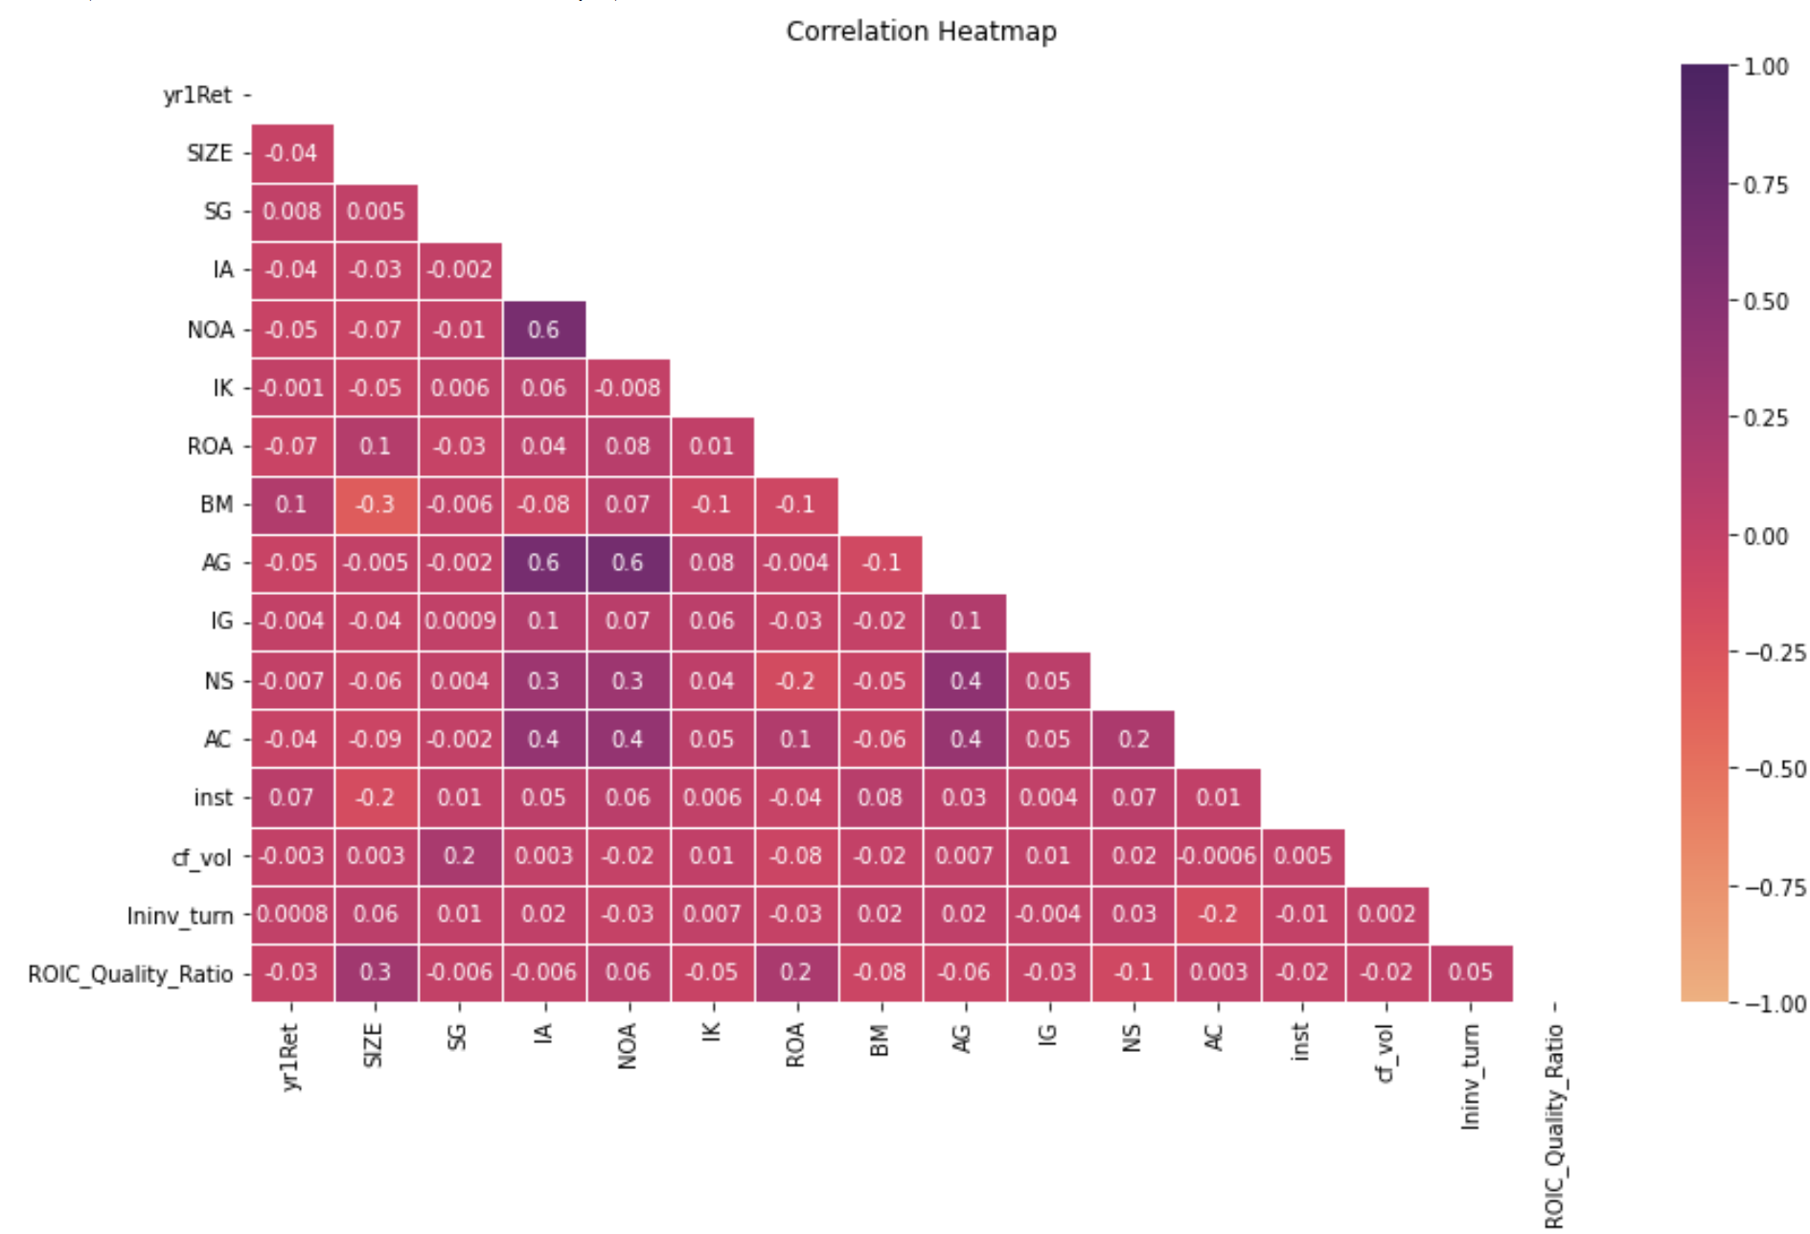
Correlation between Factors
Factors that were dropped due to high correlation:
Asset Growth
Investment to Assets
Factor kept:
Net Operating Assets
Notes:
A company's investment activities directly influence its net operating assets, asset growth, and investment to assets ratios. Companies with higher levels of investment tend to experience higher asset growth and an increase in net operating assets. Net operating assets and asset growth ratios reflect how efficiently a company is managing its assets to generate revenues and profits.
We kept NOA because of tstats were better for it. Economical reasoning: Net operating assets can provide insights into a company's operating efficiency, business model, earnings quality, and industry-specific relevance, which are all essential factors in understanding a company's economic performance and potential for future growth.

Slide 11
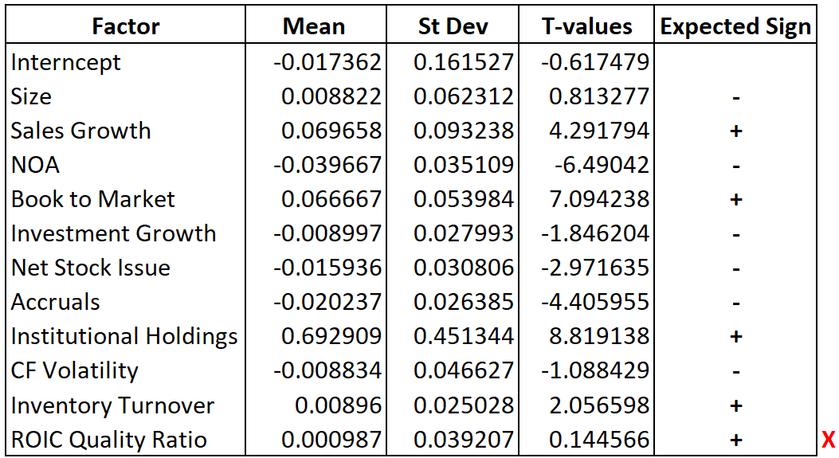
In-Sample Model (1985 - 2007)

Slide 12
Portfolio Performance

Slide 13

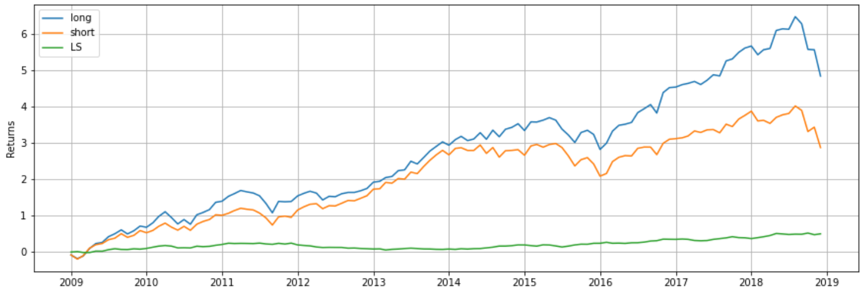
Portfolios’ Returns

Slide 14
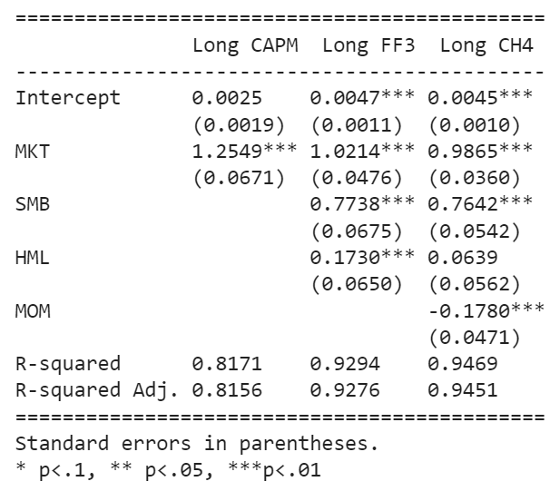
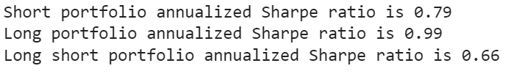
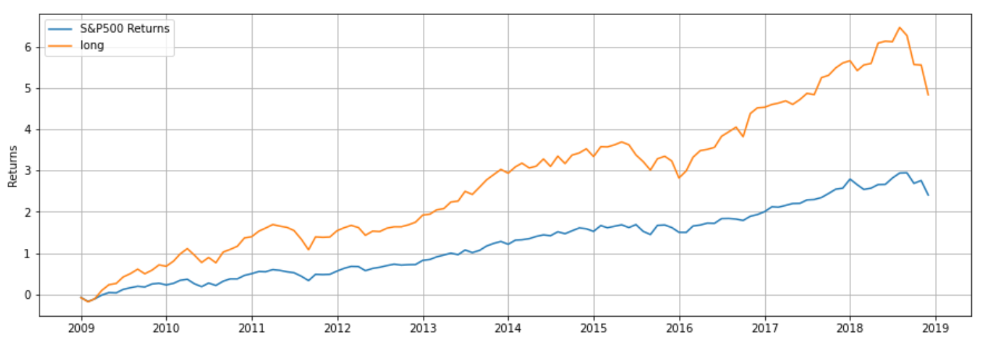
Long Portfolio Performance
Significantly outperforms market
Statistically significant alpha
Highly correlated to the market

Slide 15
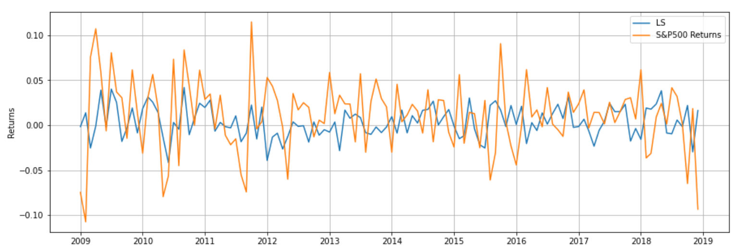
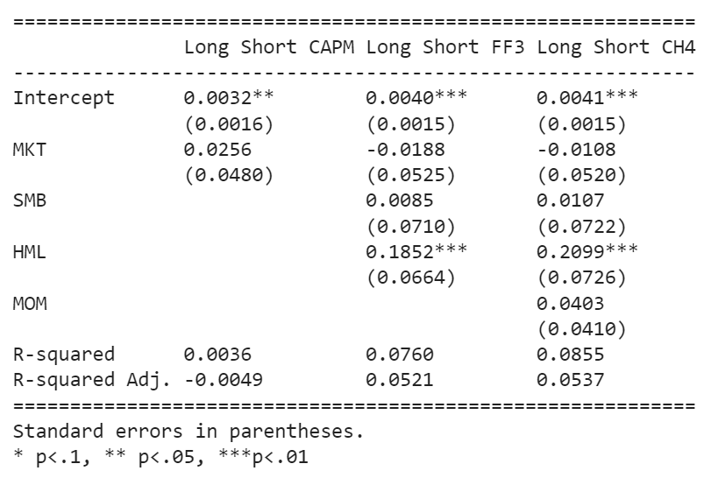
LS Portfolio Performance
Very Low Volatility
Significantly Lower Returns
Very Low, statistically insignificant beta
Low but statistically significant alpha

Slide 16
Portfolio Comparison

Slide 17
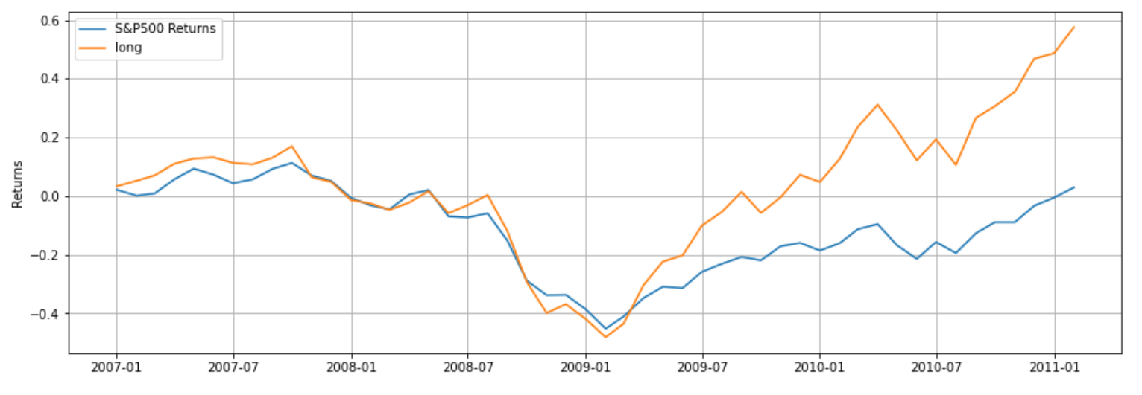
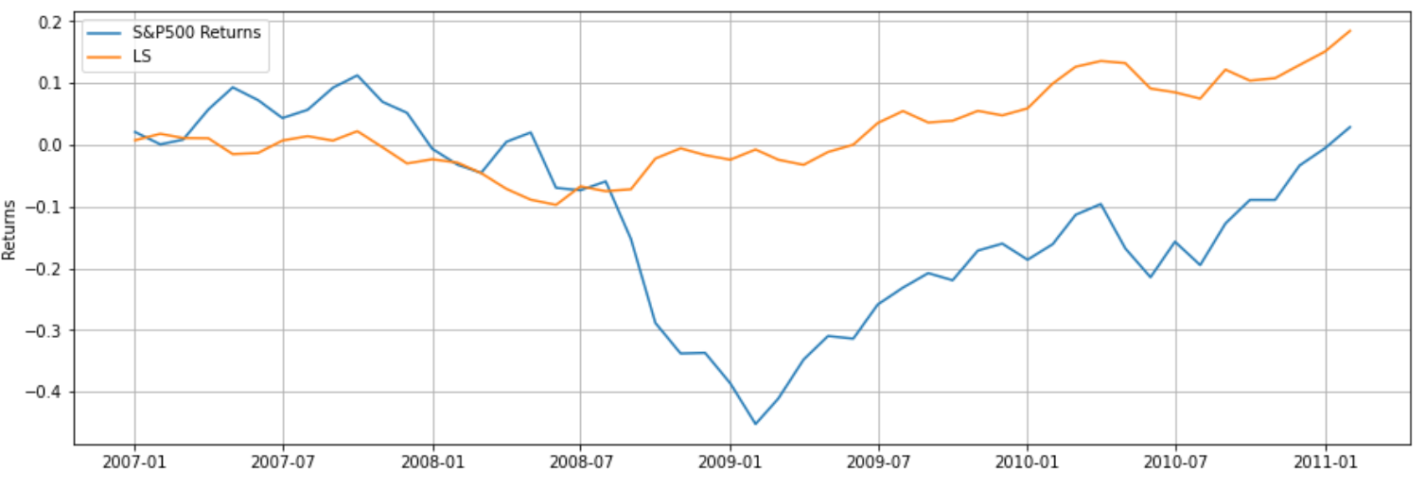
LS vs Long
Long Only
Long only Portfolio
Significantly Higher Returns
Higher Sharpe Ratio
High Correlation to Market
Long Short Portfolio
Robust to market downturns
Low volatility
May be difficult to implement for retail investors
Long Short:

